Slide 1
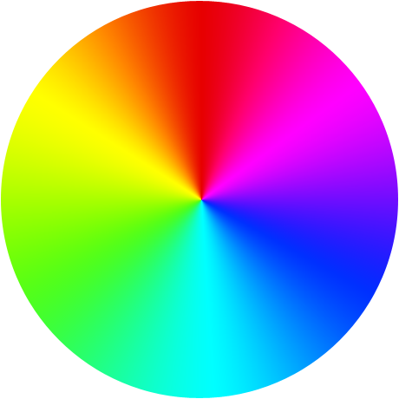
An effective solution for color blind people using color detection model

Slide 2
Team Details
Faculty Mentor
Dr Hitesh Kumar Sharma
Members
Adesh Kumar Gupta
Shankey Gupta
Tushar Singh
Utkarsh Sandeep Singh

Slide 3
Abstract
In this project a model is been created which aims to provide a solution for the people that suffer from a well-known vision deficiency called color blindness. The model aims to help people like them in detecting the colors which is hard for them to recognize.
As color blind people are also restricted from various areas which also include some professional fields just because of their lack of distinguishing some different colors. By developing this model, we can make a system to reduce this deficiency by the use of technology, so that it can help them without even getting it cured.
The technique being used in order to develop a setup for the identification of colors is Image Processing. It uses 2 approach first being to detect the color and the second being the edge detection of the object.
It then processes the image of the object placed in front of the camera and displays the color along with its corresponding color code depending of the shade of the color. The model after its successful development in future can be later transformed in form of some portable device which can be carried by people suffering from color blindness to use it whenever they are in need.

Slide 4
Introduction
Now in order to implement the setup and develop the model which would help as an aid for the color blind people, some techniques and methods needs to be put in use which include libraries like NumPy, OpenCV and a technique called Image Processing.
OpenCV(Open Source Computer Vision) library aims at real time Computer Vision. It is mainly used to do all the operations related to images.
NumPy is Python Package which stands for Numerical Python. This library consists of multidimensional array objects and a collection of routines for processing of array.
Image Processing technique is used to perform some certain operations on an image, in order to get an enhanced image as an output or to extract some useful information from the image. It acts as a type signal processing in which input is an image and output may be an image or characteristics/features associated with that image.

Slide 5
Problem Statement
Nowadays most of the people can be seen as a victim of Color Blindness which is an incurable disease because of genetic disorder. It can be cured by some genetic therapy but it is very much costly. The problem they face is that these people are unable to differentiate between shades of color or when two colors are mixed together so it will be very difficult for them to see item’s color clearly. So, the problem is how it can be analyzed without curing the disease.

Slide 6
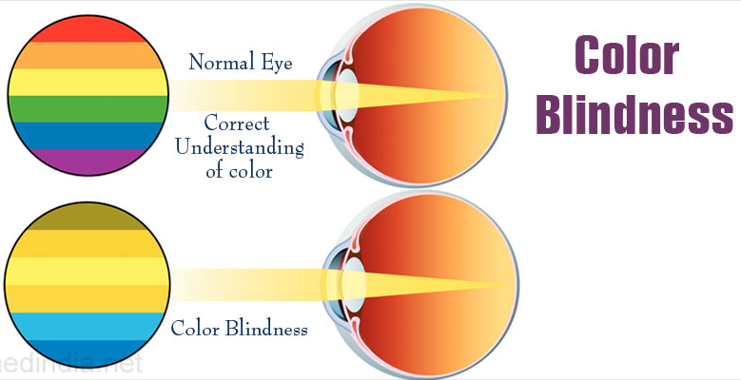
An Example
The image shown here clearly depicts an example of how a color blind eye is different from a normal eye and how difficult it is for these people who suffer with this deficiency to properly visualize a specific color sometimes.
These people may find their views and their observations on how an object looks like to them a lot different then how other people see it.
A color detection model should prove helpful and beneficial for them so that they don’t get pushed back among other people in today’s generation and should get all the opportunities that they deserve but can’t achieve due to their problem which restricts them.

Slide 7
Literature Review
[1] Color can be identified from the sensory optic nerves of the eyes. Color can only be seen or identified when a source of light is applied to an object. Color blindness can be termed as inability of the differentiation between colors. It is incurable disease that can be termed as lifelong disease. Edges can be very helpful in color differentiation boundary.
[2] Color detection model can be used in mixing of colors especially in paints, dyes and color pigments. It can be also very helpful in to differentiating colors that are used in robotics and in other medical fields. It can also be used in Graphic Arts Industry. Other implementations can also be used in agricultural industry like especially detection of quality of soil.
[3] Color Detection can be used in agriculture industry to find the weeds the along with the crops. Via color detection weeds can be identified and destroyed and the crops can be saved. It can be also used in medical industries to detect the disease and other disorders especially in face and other internal diseases like cancers.
[4] The main aim of computer vision is to analyze the behavior of human eye and the reduction of human effort. Through computer vision various task can be done that is done by human eye, whether to detect the object or identify its color. By this method it is very helpful to detect the symptoms of the disease and the other applications in other industries like agriculture.

Slide 8
Objectives
To identify the color of the given object kept in front of the camera.
To find the respective shade of that color.
To represent the color found on the object and generating its respective RGB color code.

Slide 9
Methodology
Theory:
Color detection model is used to find the respective color, and its’ shade. Color detection model will be useful for people having disorder of color blindness, agricultural fields and in medical fields as well.
For the implementation of this technique, we need to have some python libraries:
OpenCV
To use camera and to identify object’s color from that camera in our code.
NumPy
To store the range of the color on the screen, i.e. to identify the location of the colors present on the screen.

Slide 10
Approach:
Importing Modules
Capture livestream video through webcam
Converting image frame from BGR(Blue-Green-Red) to HSV(Hue-Saturation-Value)
Defining the range of each color in the image.
Find range of the colors in the frame
Track the color and draw a rectangle around it
Display output as a video stream in a window with the colors being tracked displaying their names and color codes as soon as it tracks an object.

Slide 11
System Requirements
Hardware:
RAM- 4GB
Processors- Intel Core i3/i5/i7
HDD- 1 GB
Software:
Operating System- Windows 10/8.1/8/7/XP | Ubuntu| RedHat
Programming Language- Python

Slide 12
Schedule(Pert Chart)

Slide 13
References
Documented Reference:
[1] An image processing technique for color detection and distinguish patterns with similar color: An aid for color blind people
https://www.researchgate.net/publication/282270361
[2] Methods and Means for Color Detection and Modification
https://patents.google.com/patent/US4488245A/en
[3] Method for color detection in video images https://patents.google.com/patent/US6574363B1/en
[4] Study on Object Detection using Open CV – Python
International Journal of Computer Applications (0975 – 8887) Volume 162 – No 8, March 2017

Slide 14
The End THANK YOU!

